Slide 1
Theory Of Automata
Lec 01 - Languages
Instructor
Rana Marwat Hussain

Slide 2
Text and Reference Material
Introduction to Computer Theory, by Daniel I. Cohen, John Wiley and Sons, Inc., Second Edition

Slide 3
Assessment Methodology
There will be Mid term exam and final exam. The final exam will be comprehensive. These will contribute the following percentages to the final grade:
Mid-Term Exams 30%
Assignments 15%
Quiz 15%
Final Exams. 40%

Slide 4
Outline
Introduction to the course title
Formal and Informal languages
Alphabets, Strings, Words
Null string
Defining languages
Valid and In-valid alphabets
Length of a string
Reverse of a string

Slide 5
Automata – What is it?

Slide 6
What does automata mean?
It is the plural of automation
“A machine which can calculate”
“something that works automatically”
Computer theory = Static machines (Computer as state machine)
Input
Output
Start State
Halt State
Execution / Running State

Slide 7
Introduction to Languages
Language: Medium of communication
System: Programming Language
There are two types of languages
  Formal Languages (Syntactic languages)
  Informal Languages (Semantic languages)

Slide 8
Formal Languages
Formal: all the rules of the language are explicitly stated
Well documented language
Also known as “Natural Programming Languages”
Communication can be done between
  Human – Human (Natural Languages)
  User – System
  System –User (Programming Languages - PL)
  System -System

Slide 9
Natural Languages
Well defined (set of rules) , Well known, Well documented
Examples
  English, Urdu, Arabic, French, etc
Not well documented (casual)
  Hindko, Balti, Pahari, etc
Parts of English Language
  Set of alphabet (26 letters)
  Words
  Grammar (Set of rules)
  Sentences
Example: I ate an apple. (Subject verb article object /noun)

Slide 10
Parts of Language: Alphabets
Language:
  Symbols with formal rules
  Specified set of strings of characters from the alphabet
Definition:
  A finite non-empty set of symbols (letters)
  denoted by Σ ( Greek letter capital sigma)
  Basic unit of language
Example:
  Σ={a,b}
  Σ={0,1} //language which computer can understands.
  Σ={i,j,k}
  Σ={a,b…….z} //small case English language alphabet set

Slide 11
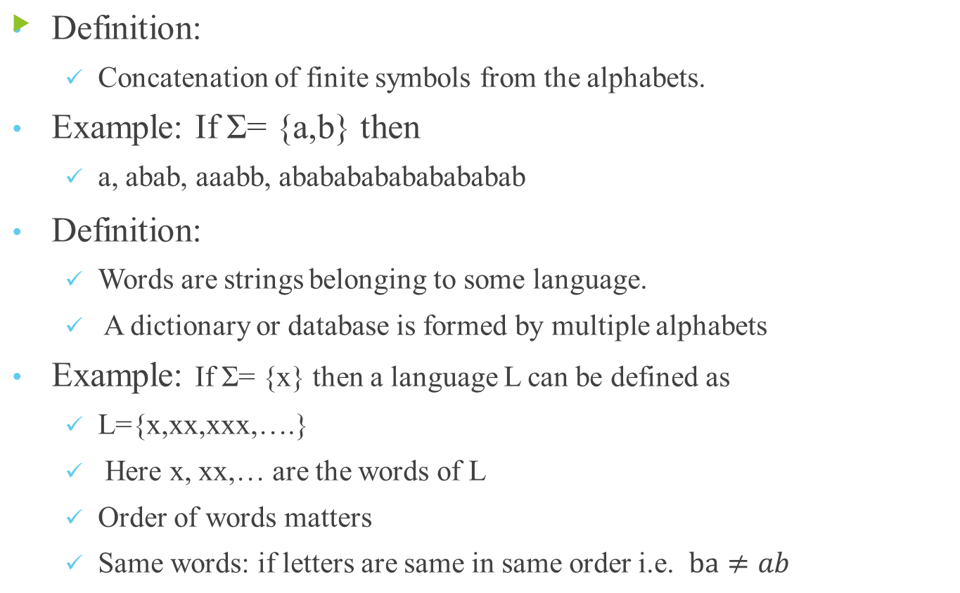
Parts of Language: Word /Strings

Slide 12
NOTE:
All words are strings, but not all strings are words.
Empty / NULL String:
  a string with no symbol at all
  denoted by (Capital Greek letter Lambda) Λ
  Or by (Small Greek letter Lambda) λ
Syntax Error:
  Grammatical mistakes
Logical Error:
  Grammatically correct but not meaningful
  I ate an apple. Vs I ate a ship.
  Grammar cant find the error of ship because its logical

Slide 13
How to describe a Language?
Descriptive from:
  Describe in English language.
Example: Let x be the alphabet Σ= {x} then L can be defined as
  L={x^{n} : n=1,2,3,…..} or L={x, xx , xxx,….}
For a language having two alphabets Σ= {a,b}
  Descriptive form: all words of a and b
  {a, b, aa, ab, ba, bb, aaa, aab, ……..}
  Descriptive form: all words start with a
  {a, aa, ab, aaa, aab, ……..}
  Descriptive form: all words based on a and b having length 2
  {aa, ab, ba, bb}

Slide 14
Valid /Invalid alphabets
Example: if Σ₁= {a, b}, and Σ₂= {ab, c, d} are two different sets of alphabets
Check string “abab” is valid or not.
string can be tokenized in two different ways
(a) (b) (a) (b)
(ab) (ab)
For Σ₁
Both tokens identifies that the string is valid
For Σ₂
second token identifies that the string is valid

Slide 15
Things to Remember
While defining an alphabet it should be kept in mind that ambiguity should not be created.
For alphabet of letters consisting more than one symbols, no letter should be started with the letter of the same alphabet
i.e. one letter should not be the prefix of another.
However, a letter may be ended in the letter of same alphabet
i.e. one letter may be the suffix of another.
Σ₁= {B, aB, bab, d}, Σ₂= {B, Ba, bab, d}
Σ₁ has a valid alphabet while Σ₂ has invalid alphabet.

Slide 16
Functions Perform on Alphabets
Length of string
Reverse
Null string
Kleene’s Closure or Kleene Star
Palindrome

Slide 17
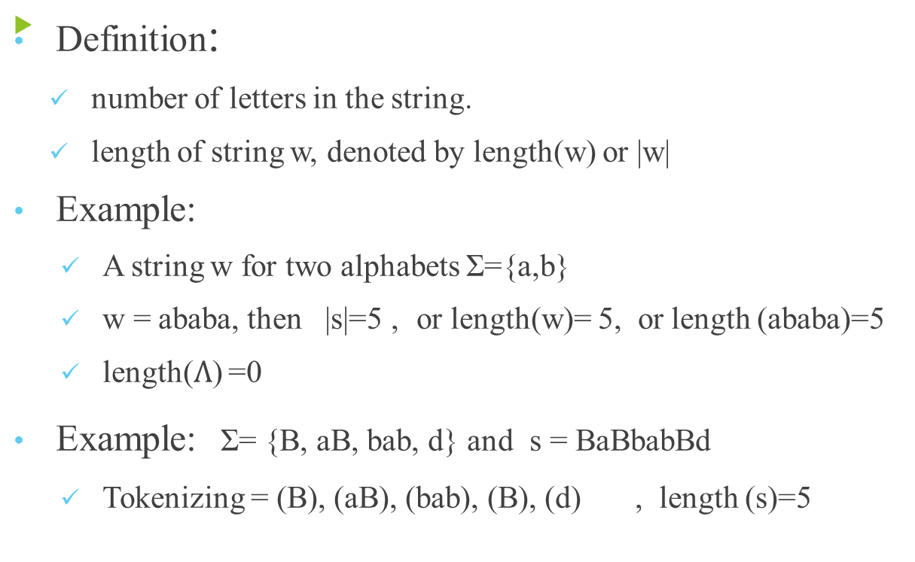
Length of Strings

Slide 18
Reverse of a String
Definition:
writing the letters of s in reverse order.
reverse of string s, denoted by reverse(s)
Example:
If s=abcac is a string defined over Σ={a, b, c} then
reverse (s) = cacba or reverse(abcac) = cacba
Example: Σ= {B, aB, bab, d}
s = BaBbabBd , Tokenizing = (B), (aB), (bab), (B), (d)
Rev(s)=dBbabaBB

Slide 19
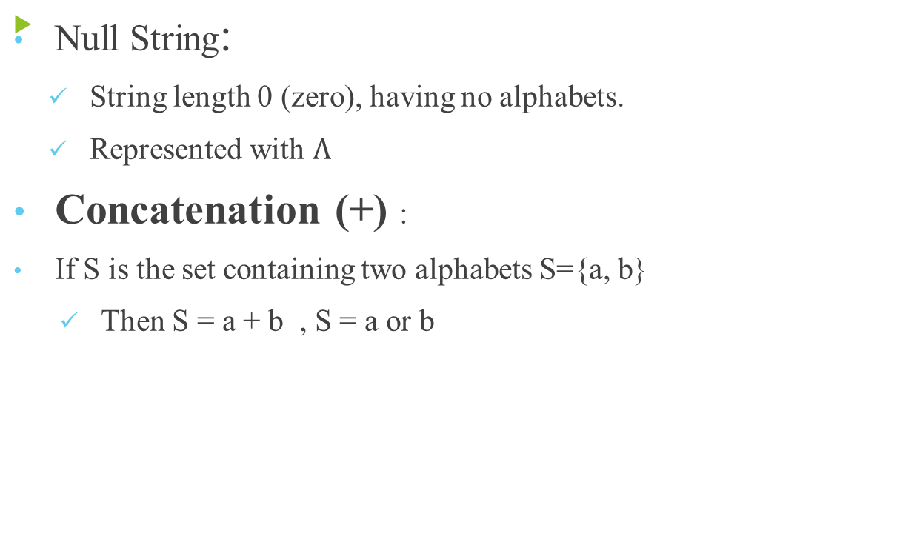
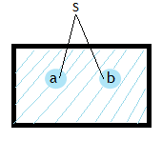
Null String

Slide 20
PLUS Operation (⁺)
Plus Operation is same as Kleene Star Closure except that it does not generate Λ (null string), automatically.
Example:
If Σ = {0,1}
Then Σ⁺ = {0, 1, 00, 01, 10, 11, ….}
If Σ = {aab, c}
Then Σ⁺ = {aab, c, aabaab, aabc, caab, cc, ….}

Slide 21
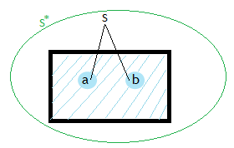
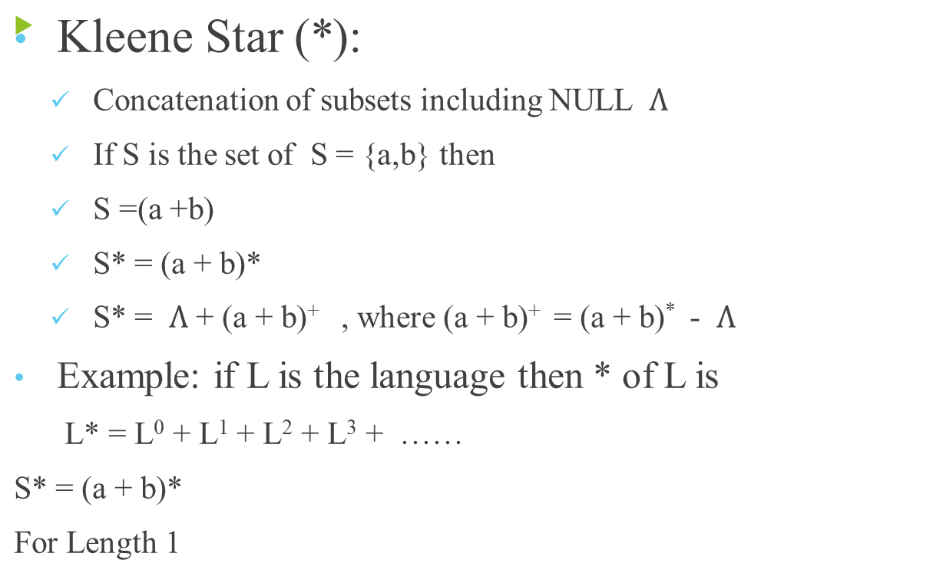
Kleene Closure

Slide 22
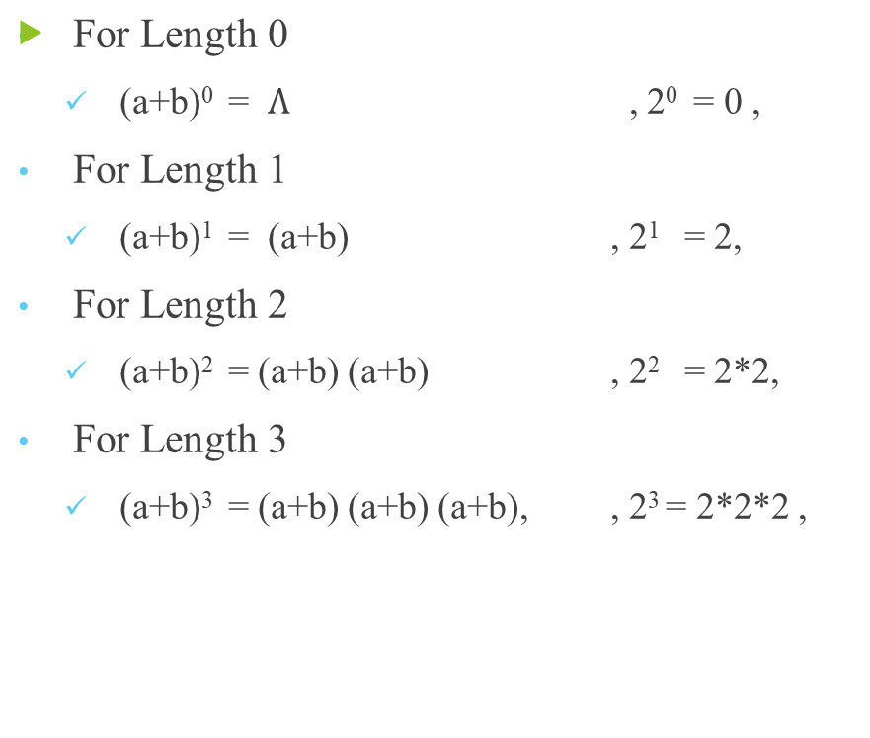
Kleene Closure – contd.

Slide 23
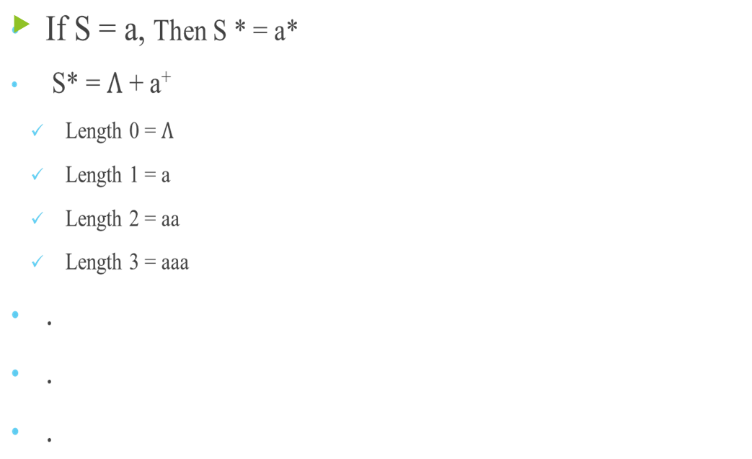
Kleene Closure - Example

Slide 24
Kleene Closure – Class Activity
Find the Kleene Closure of following
S = {x}
S = {0,1}
Prove that S* = S**

Slide 25
ThankYou

